Slide 1
CCC831 2019
Session 4-5
Reference reading: Kothari ch. 11

Slide 2
The Dual of the Simplex Form
Place the Simplex in Matrix form and then rotate the matrices to obtain the Dual LP problem. For details refer to QT pg. 229
The Dual LP is useful because a problem with n unknowns and m constraints in the primal problem, becomes a Dual problem of m unknowns and n constraints.
This is useful when the primal problem contains a large number of unknown variables. Fewer unknowns makes it easier to find an optimal solution.

Slide 3
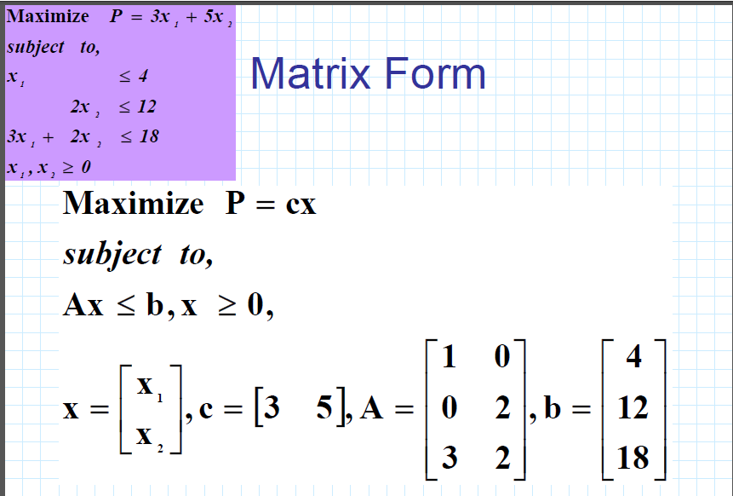

Slide 4
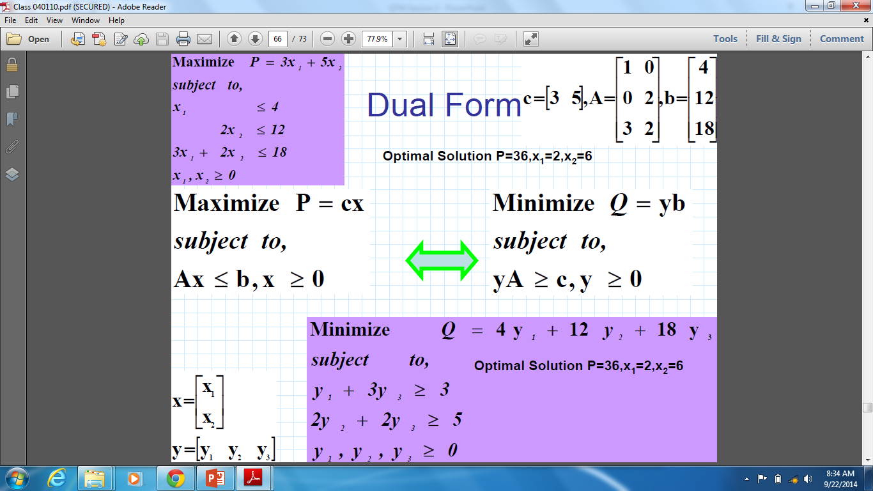

Slide 5
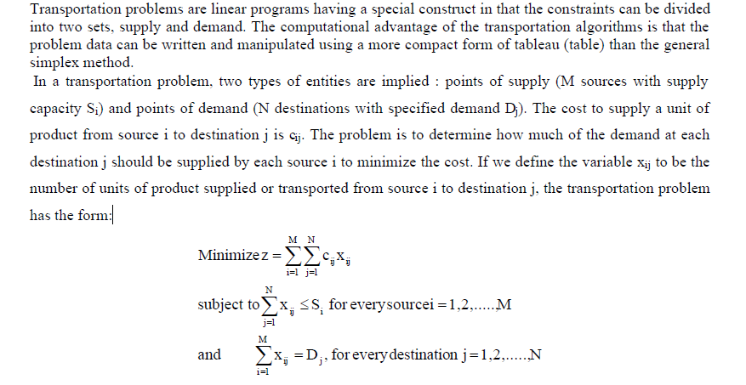
Transportation problem

Slide 6
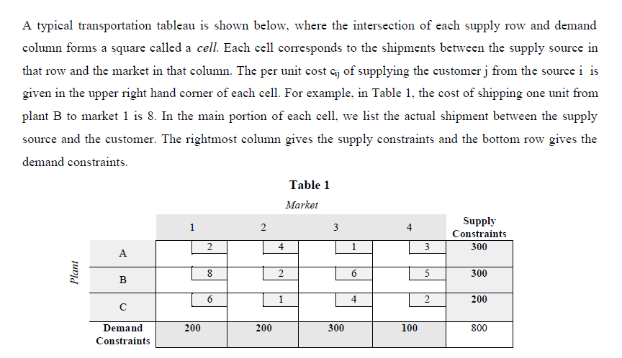

Slide 7
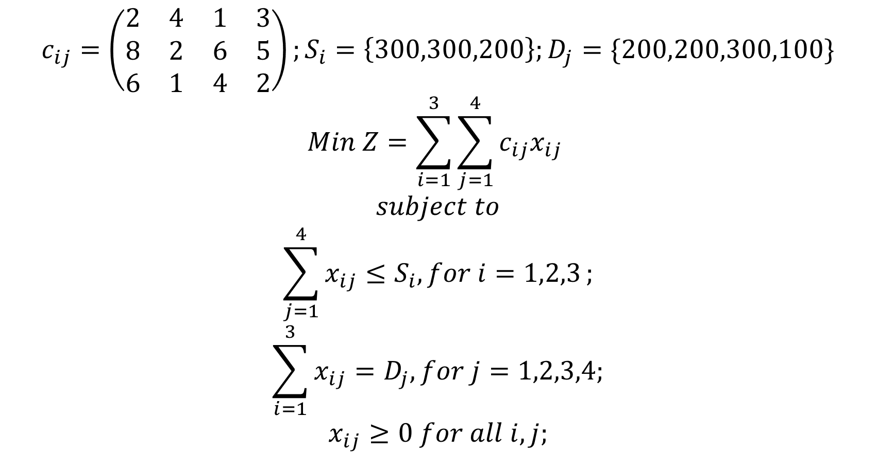
Example LP problem for the transportation problem
$$c_{ij}=\left(\begin{matrix}2 & 4 & 1 & 3 \\ 8 & 2 & 6 & 5 \\ 6 & 1 & 4 & 2\end{matrix}\right);S_{i}=\left\{300,300,200\right\};D_{j}=\{200,200,300,100\}$$
$$Min Z=\sum_{i=1}^{3}{\sum_{j=1}^{4}{c_{ij}x_{ij}}}$$
$$subject to$$
$$\sum_{j=1}^{4}{x_{ij}≤S_{i}, for i=1,2,3};$$
$$\sum_{i=1}^{3}{x_{ij}=D_{j}, for j=1,2,3,4;}$$
$$x_{ij}≥0 for all i,j;$$

Slide 8
The Assignment problem
The problem involves the assignment of n facilities to n tasks, with associated cost (or profit) of assigning a particular facility to any particular task.
No. of facilities and tasks must be equal. In case of inequality we assign dummy tasks or facilities, as appropriate.
Dummies will have zero profit or cost.

Slide 9
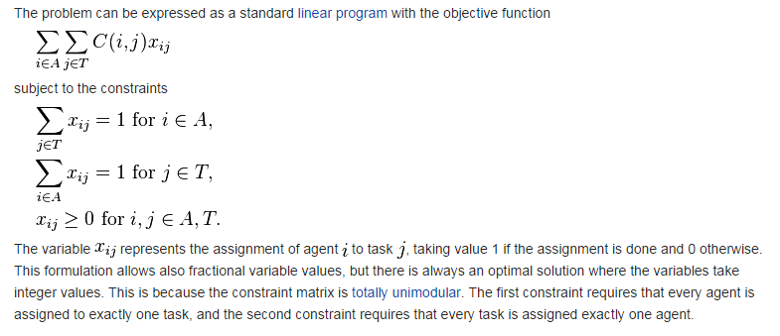

Slide 10
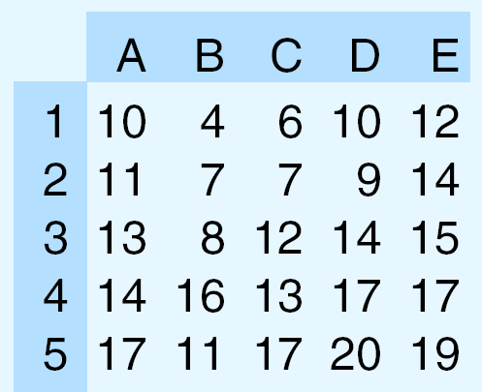

LP setup for assignment problem example
Example data: $c_{ij}=$
Problem:
$$Min Z=\sum_{i=1}^{5}{\sum_{j=1}^{5}{c_{ij}x_{ij}}}$$
$$subject to$$
$$\sum_{i=1}^{5}{x_{ij}=1, for j=1,2,3,4,5};$$
$$\sum_{j=1}^{5}{x_{ij}=1, for i=1,2,3,4,5;}$$
$$x_{ij}≥0 for all i,j;$$

Slide 11
Profit Matrix:
J1 J2 J3 J4
W1 67 58 90 55
W2 58 88 89 56
W3 74 99 80 22
(D) 0 0 0 0

